Slide 1

Multi-Media Platform Architecture
Proposal to position a Multi-Media Collaboration Platform within the Enterprise Architecture
Notes:
A note for instructors about the format of the instructor materials:
The following materials are for the use of the instructor in teaching the RMUC course. Each instructor needs to decide how to use the slides to best fit his or her teaching style.
Many slides are accompanied by instructor notes and/or by student notes. The instructor notes on a slide give suggestions to the instructor about how to present the information on the slide, particular points to emphasize, and background information. The student notes on a slide give more detail and additional information about the topic of the slide.
Instructors should be familiar with the student notes in addition to the instructor notes because the student notes contain detail that the instructor may need to mention. The instructor should NOT expect or encourage students to read the student notes during the class itself.
Suggestions for introductions are given on the following slide.

Slide 2

Preface
This is a proposed 3-layer architecture for positioning multi-media content within our knowledge repository as well as a multi-media collaboration platform within a service framework.

Slide 3
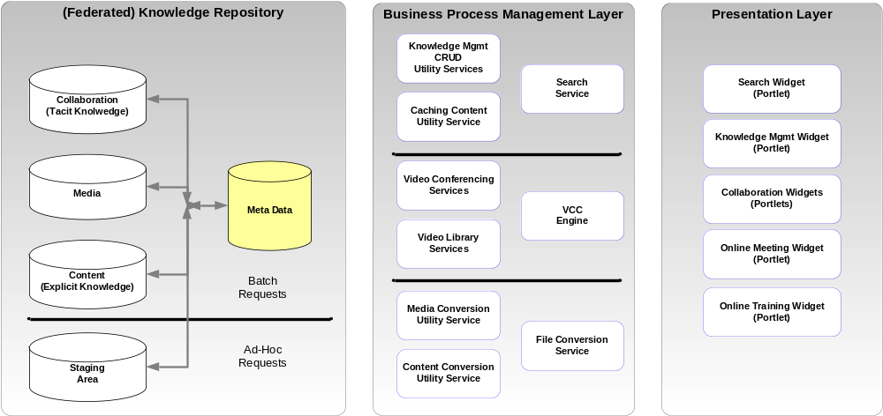
3-Layer Architecture

Slide 4
Positioning Multi Media Content
This type of content requires a large amount of space in its native format (audio & video files are quite large when uncompressed). We would likely store the native files in separate repositories (probably federated by type of content).
The native content would need to be converted to Flash Audio or Flash Video files (highly compressed).
  Ex. 2.25GB MPG file converts to a 24MB FLV file
Both the native content & converted content files would need to be published to federated content stores.
  Note: It might make sense to maintain regional storage to improve response times and limit bandwidth utilization.

Slide 5
Positioning of “other” content
There are of course other types of content that we already capture (documents, MS Office content, PDFs, CAD drawings, reports, etc.).
All of these can be converted to a PDF format, which is a commonly available reader (w/in & w/o HSP), and would eliminate the need for additional readers on the client. The PDF format would allow the multi-media collaboration engine to transport (share) these files in a much more efficient manner since the file is streamed through the client’s Flash Player.

Slide 6
Staging of Content
Published content (Native & PDF formats) will be placed in a federated ECM repository for access by internal consumers (initially). As part of the publishing process, batch services will convert the content into Flash-ready formats and place by formats into the ECM (dynamically tagging the content with the Meta Data pointers per the tags selected by the publisher).
Ad-Hoc content may need to be loaded for online conferences. Separate staging areas will need to be made available for uploading content (native format), which can be converted (dynamic) into a Flash-ready format for consumption by the multi-media platform.

Slide 7
Service Facade
There are 3 sets of services we might want to initially create for handling any type of content:
  First set consists of basic search, publish and retrieval services (CRUDS if you will)
    Note: The Create / Update service(s) is responsible for aligning Meta Data with the published content.
  Second set consists of the services that would invoke the multi-media engine for initiating streamed threads to end users.
  Third set consists of conversion services which are event driven based on:
    Published content (batch conversion)
    Ad-Hoc content (dynamic conversion)

Slide 8
Presentation Layer
Instead of building out a traditional web portal with all the complexities associated with web servers. We could design a series of portlets or widgets, based on concepts embodied in the JSR 168 standard and leveraging the emerging JSR 268 standard. The goal here is that these would be published as a series of reusable presentation layer components.
Then end users could select these for inclusion into their existing web portals (Sharepoint, Oracle, SAP, Liferay, JBoss, Netvibes, Yahoo, IGoogle…) or applications (reference via a simple URI).

Slide 9
Presentation Layer
The difference is that we would publish these as FLASH objects (apps) that could run in FLASH players on any device.
  The goal (if possible) would be to eliminate the need for Java Engines or .NET engines to run on devices thus freeing up CPU cycles on the clients
  These widgets could be embedded in any application via a URI reference
  This is an innovative approach for delivering a fully abstracted presentation layer that can be built using a federated model.

